Slide 1
EMAIL SPAM DETECTION
Dhruv Lunagariya--20BCP153 Dhruv Patel--20BCP152

Slide 2
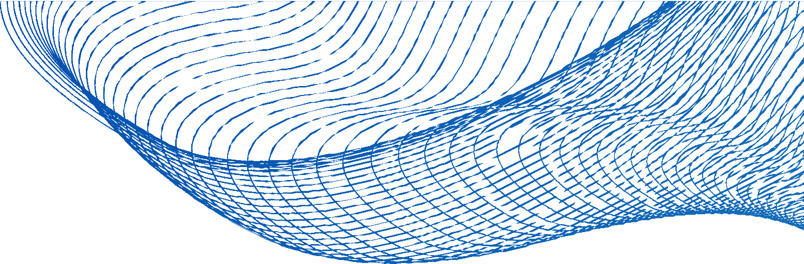
TABLE OF CONTENT
Introduction
Literature Review Dataset Description Proposed Method References

Slide 3
INTRODUCTION
spam ( junk mails) mails are unwanted or unsolicited messages sent over the internet.
sometimes these spam mails become illusive.spam mail conains illusive offers which motivates consumers to provide their personal data to hackers.
the first spam was sent out in 1978 by Gary Thuerk an employee of Now Defunct Digital equipment corp. he sent mail to promote a new product.
this mail went out to about 400 of the 2600 people who had email accounts.

Slide 4
LITERATURE REVIEW
Author | Dataset size | Classification Approach | Result
Shrivastava (2014) | Corpus of 2,248 emails with 1,346 spam and ham texts | Rule based spam detection ﬁlter | Accuracy-82.7%
Luo et al. (2011) | Spam corpus with 4,150 spam and 1,897 ham mails | Rule extraction, optimization, and rule ﬁltering models are used | Accuracy-98.5%
Fuad Deb & Hossain (2004) | Email corpus with 271 training and 30 test email text | Fuzzy Inference System with a set of Fuzzy rules | Accuracy-90%
Mohammed (2013) | Email-1,431 rows in dataset | SVM, K-NN, NB | Accuracy-85.96%

Slide 5

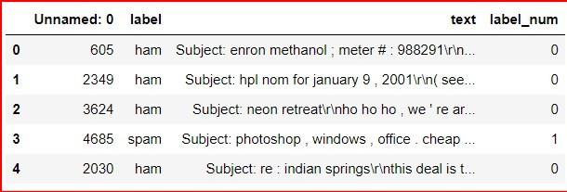
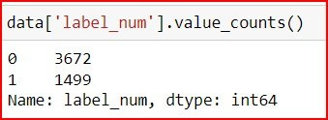
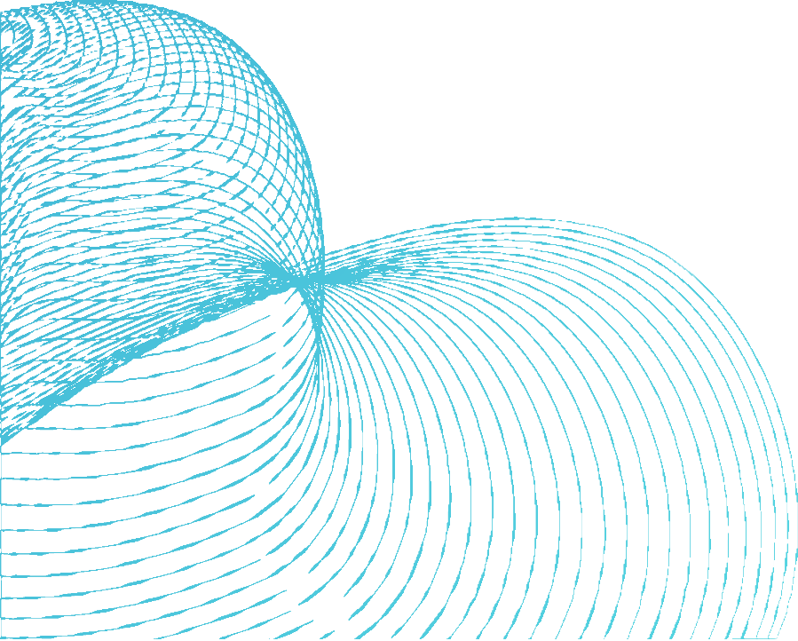
DATSET DESCRIPTION
we have chosen our dataset from kaggle.
dataset contains colums and 5171 rows.
the output feature "label_num" has 2 classes. class-0 (ham mail), class-1(spam mail)
class-0--> 3672 samples. class-1-->1499 samples.

Slide 6

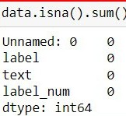
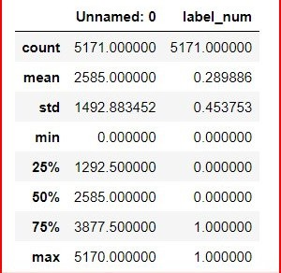
DATSET DESCRIPTION
dataset does not contains any NULL values.
some statistical information.

Slide 7



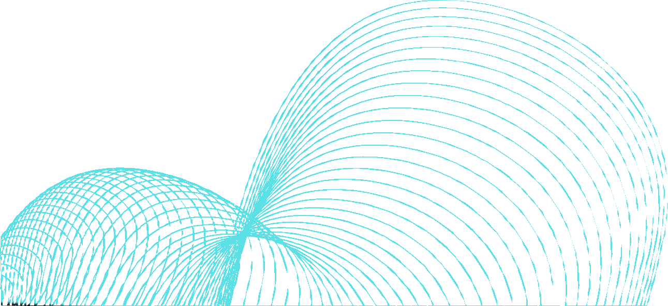

step-1--> data preprocessing
this step contains data preprocessing such as removal of NULL values, filling of emply values, feature selection, feature extraction etc.
METHOD
we have proposed Machine Learning based method.
step-2--> model building(training)
this step includes model building on preprocessed dataset using different classification algorithms.
we are going to apply different classification algorithms like logistic regression, naive Bayes, random forest etc.
step-3--> model evaluation(testing)
this step includes model evaluation by some random values as input.

Slide 8









TRAINING PHASE
feature selection NULL value removal etc.
processed data
raw data
preprocessing
classification algorithms
training
trained model

Slide 9


TESTING PHASE
new data
trained model
output

Slide 10



ALGORITHM
Logistic regression
Naive Bayes
Naïve Bayes algorithm is a supervised learning algorithm,
Logistic regression is a supervised machine learning algorithm mainly used for classification tasks where the goal is to predict the probability that an instance of belonging to a given class.
Statistical Model Accuracy : 98.45%
the Bayes theorem and used for solving
which is based on
classification problems. probabilistic classifier, which means
it predicts on the basis probability of an object.
Accuracy : 91.68%
of the

Slide 11

CONCLUSION
We are able to classify the email as spam or not.
Successfully apply Machine learning algorithm such as Logistic regression and Naive Bayes.
Logistic Regression demonstrated exceptional performance with an accuracy rate of 98%.
In Naive Bayes, slightly less accurate at 91%.

Slide 12
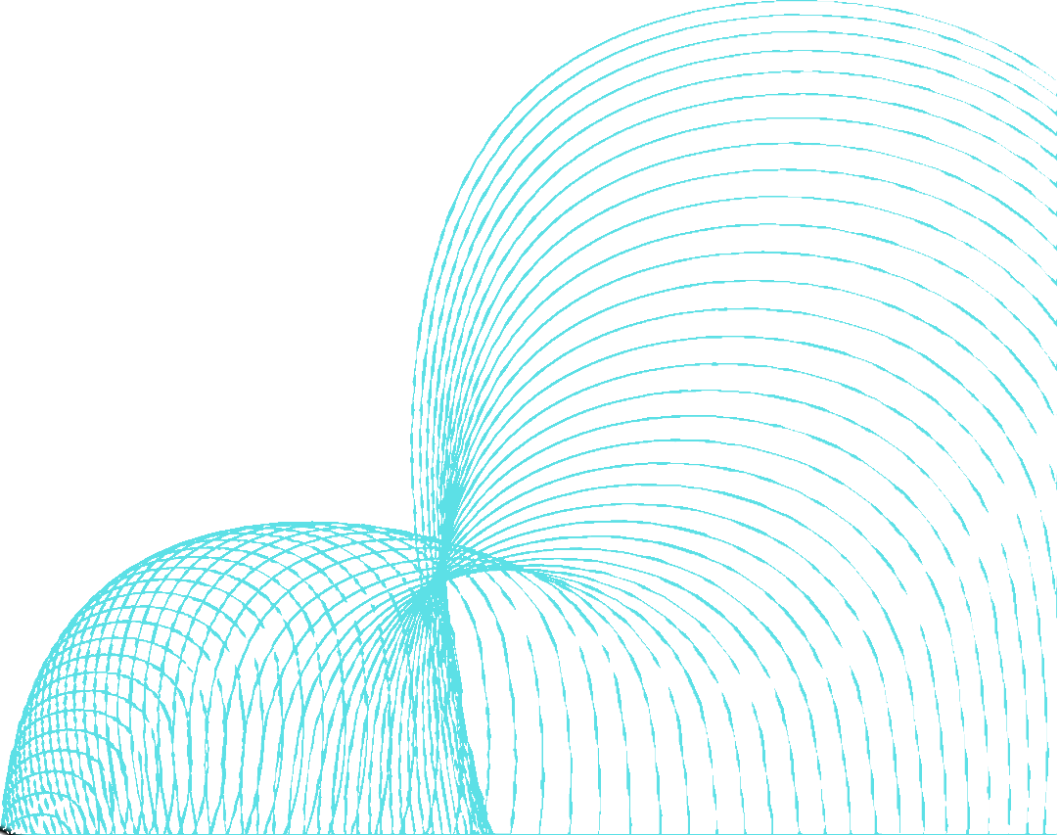
REFERENCES
https://www.researchgate.net/publication/357972513_A_systematic_literature_review_on_spam_content
_detection_and_classification
https://www.kaggle.com/datasets/venky73/spam-mails-dataset 3.https://www.techtarget.com/searchsecurity/definition/spam

Slide 13

THANK YOU

